Slide 1
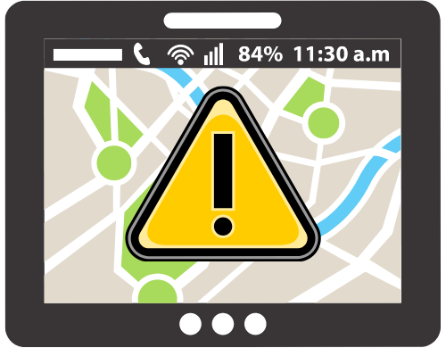


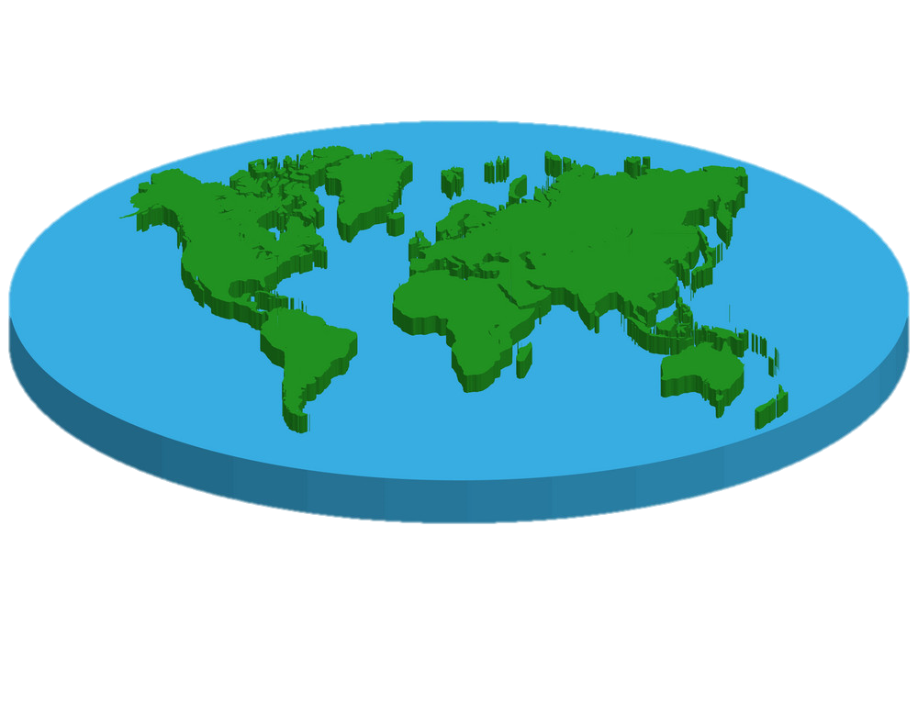
Deluby
cation
ICS26011 – Project
Prepared by: Members: Norada, Ava Julia L. Mariano, Joshua Rene M. Wong, Richard M. Cedo, Aaron R. Rabelas, Ryu L.

Slide 2
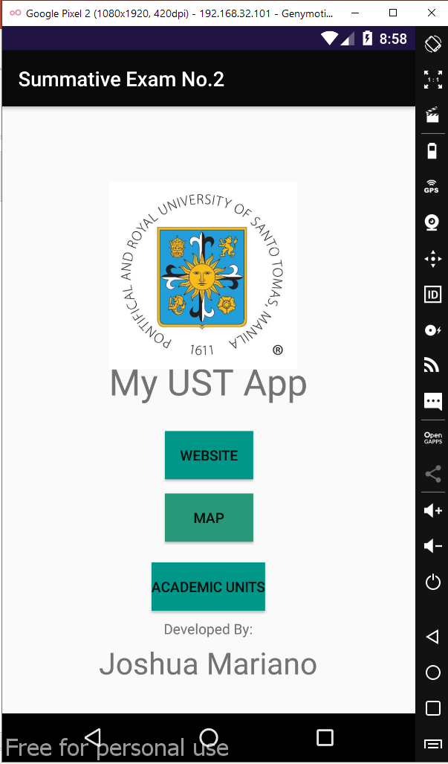




INTRODUCTION
Mock-up design
Get Started
STATEMENT OF THE PROBLEM Disaster Risk Preparedness is needed to further reduce the losses of the people when a calamity strikes. Without proper tips and precautions containing information of calamities it may lead to unnecessary injuries and casualties.
Objectives - The application intends to inform users about the current weather forecast.
- The application intends to give tips, guidelines, and nearby evacuation centers.
Deluby
cation
Deluby
cation
Get Started
Information
Weather Report
Locate yourself
Notification Settings
Evacuation Centers Near You
Safety Tips and Guidelines

Slide 3
FEATURES: GET STARTED
Mock-up design
Get Started
cation
Deluby
cation
-> Here is the first navigation button for your overview and preferences for your usage.
Deluby
Get Started
Information
Weather Report
Location Settings
Calamities Near You
Notification Settings
Safety Tips and Guidelines

Slide 4
NAVIGATION: INFORMATION
Mock-up design
Information
Delubyocation is an informational app with the primary purpose of giving updates on the latest weather forecast and that is near a selected location.
cation
Deluby
cation
Deluby
is an informational app with the primary purpose of giving updates on the latest weather forecast and that is near a selected location.
Get Started
Weather Report
Calamities Near You
Safety Tips and Guidelines

Slide 5
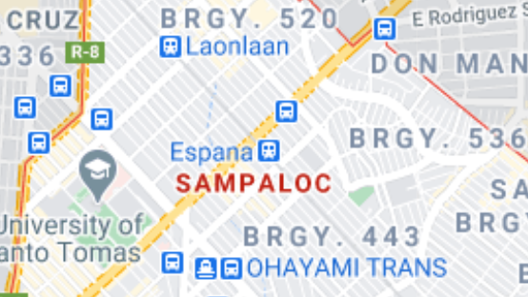
NAVIGATION: LOCATION SETTINGS
Mock-up design
Location Settings
-> Location of use will be either set manually on a pre-selected pinned location of where the user generally is
Deluby
cation
Auto-located, pre-selection
You are in Sampaloc, Manila
Set it manually
Get Started
Weather Report
Calamities Near You
Safety Tips and Guidelines

Slide 6
NAVIGATION: NOTIFICATIONS
Mock-up design
Notification Settings
-> Notifications can be set to your preferences to which ones would on, minimal (will appear to your phone but would not ping or ring), or off
Deluby
cation
Fully Secured
Get Started
All notifications will alarm you
Minimal
Weather Report
Calamities Near You
None
Safety Tips and Guidelines

Slide 7
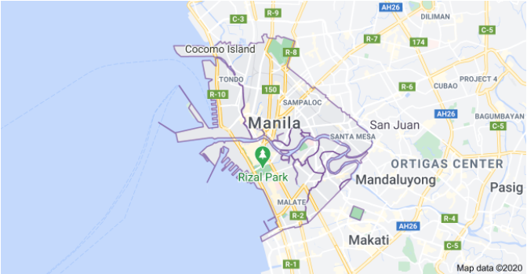
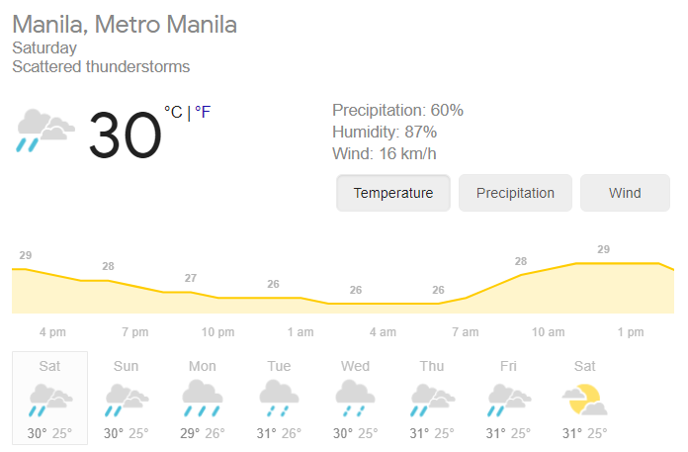
FEATURES: Weather Report
Weather Report
1. Notifies user on weather reports Examples: - Upcoming thunderstorms - Temperature - Day today
For more information please refer to:
https://www.accuweather.com/en/ph/manila/264885/weather-forecast/264885 https://www.weather-forecast.com/locations/Manila/forecasts/latest https://www.timeanddate.com/weather/philippines/manila

Slide 8
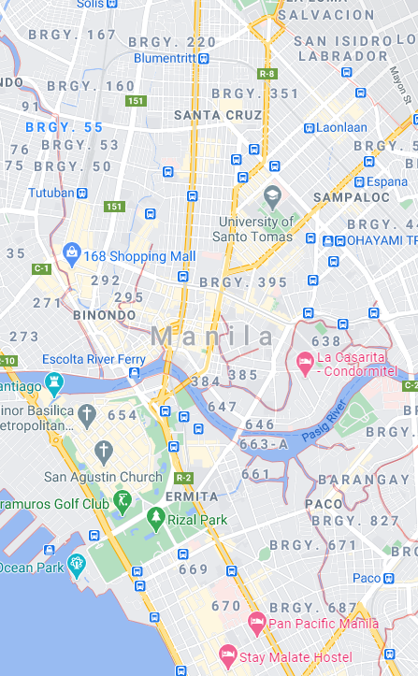
LIMITATIONS & NEARBY EVACUATION CENTERS
Evacuation Centers Near You
Limitations: The only location that the app will monitor (for evacuation centers) for now will be Manila due to the amount of data that needs to be gathered. Evacuation Centers Near You Provides the Overview of nearby Evacuation centers that will notify you and your phone
Deluby
cation

Slide 9

FEATURES
Mock-up design
Safety Tips and Guidelines
EARTHQUAKES: BEFORE
Safety Tips and Guidelines
contains the advices and tips for each calamity, for example here is the calamity which is earthquake.
EARTHQUAKES: DURING
Deluby
cation
EARTHQUAKES: AFTER
Get Started
Weather Report
Calamities Near You
Safety Tips and Guidelines

Slide 10

FEATURES: TIPS
Mock-up design
Safety Tips and Guidelines
EARTHQUAKES: DURING
-> Tab that contain safety tips detailing what one should do in each phase of a calamity
- Before - During - After
If you are INDOORS -- STAY THERE! Get under a desk or table and hang on to it (Drop, Cover, and Hold on!) or move into a hallway or against an inside wall. STAY CLEAR of windows, fireplaces, and heavy furniture or appliances. GET OUT of the kitchen, which is a dangerous place (things can fall on you). DON'T run downstairs or rush outside while the building is shaking or while there is danger of falling and hurting yourself or being hit by falling glass or debris.
If you are OUTSIDE -- get into the OPEN, away from buildings, power lines, chimneys, and anything else that might fall on you.
If you are DRIVING -- stop, but carefully. Move your car as far out of traffic as possible. DO NOT stop on or under a bridge or overpass or under trees, light posts, power lines, or signs. STAY INSIDE your car until the shaking stops. When you RESUME driving, watch for breaks in the pavement, fallen rocks, and bumps in the road at bridge approaches.
Deluby
cation
Get Started
Weather Report
Calamities Near You
Safety Tips and Guidelines

Slide 11
Thank you for listening and have a good day

